Slide 1
Graph Databases in the Microsoft Ecosystem
Marco Parenzan @marco_parenzan

Slide 3
Graph Databases…
Old theory
Niche
Neo4j
Social➔Renaissance

Slide 4
This is an exploration due to a research activity

Slide 5
Lot of people before myself

Slide 6
Not a real objective at this stage

Slide 7
Azure Digital Twin (it’s always due to IoT for me)

Slide 8
1. Digital Twin is 2. virtual representation 3. of the thing 4. ecosystem

Slide 9
Demo

Slide 10
Trigger for exploration
Device (entity)
Space (entity)
Devices relates to different spaces levels (venue, floor, room)

Slide 11
Legacy implementation strategies
IoT Hub is flat
SQL database require that Device table has relations to different entity tables (venue, floor, room)
Or single table (space) is hierical (CTE, hiericalId)

Slide 12
Agenda
Why graph
SQL Server for graphs
CosmosDb for graphs➔Gremlin
Another Gremlin star➔Neo4j
Conclusions

Slide 13
Intro to graphs

Slide 14
Graph Theory: Directed Graph
In formal terms, a directed graph is an ordered pair G = (V, A) where
V is a set whose elements are called vertices, nodes, or points;
A is a set of ordered pairs of vertices, called arrows, directed edges (sometimes simply edges with the corresponding set named E instead of A), directed arcs, or directed lines.
Notes:
Warning:

Slide 15
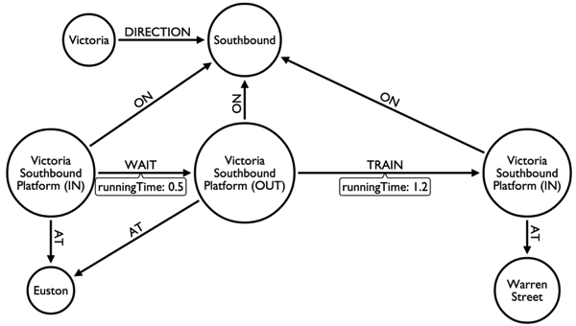
Some graph tips
Many to Many
Node and arcs
Oriented Arcs
Many args entering node
One arc entering➔Hierarchies, Trees

Slide 16
What is a Graph Database
A Graph Database is a Database that is modelled as a Graph
Traditional data modeling focuses on entities.
For many applications, there's also a need to model both entities and relationships naturally.
Both vertices and edges can have an arbitrary number of properties.

Slide 17
Edges
Edges and relationships are first class entities and can have attributes or properties
Easily express pattern matching and multi-hop navigation queries
A single edge can flexibly connect multiple nodes

Slide 18
When to use a Graph Database
You need to analyze interconnected data and relationships
Application has complex many-to-many relationships and as application evolves, new relationships are added.
Application has hierarchical data
While the HierarchyID datatype can be used to implement hierarchies, it has limitations (eg it does not allow multiple parents for a node)

Slide 19
Major Vendors in Graph Database
Neo4j
Orient DB
ArangoDB
Titan
mongoDB
Complexible Stardog
Franz AllegroGraph
Oracle
Notes:
Major Vendors
Microsoft are quite late to the graph database scene
The Graph database is mature market with lots of vendors offering graph database software. Nearly all use open source NoSQL databases
I’ve listed what seem to the most common here
Neo4j by Neo Technologies is definitely the most popular with plenty of videos and articles on graph database. Many of the images and information used in this presentation have come from their web site.
A full list can be found here: https://www.g2crowd.com/categories/graph-databases?utf8=%E2%9C%93&order=top_shelf

Slide 20
Neo4j for graphs
Notes:
Cosmos DB is Azure’s NoSQL Database-as-a-Service, born in cloud, globally distributed, highly scalable & highly available.
The first & only globally distributed, multi-model database system
2010 Project Florence
2014 DocumentDB
2017 Cosmos DB

Slide 21
Features of Neo4j
Neo4j is schema free – Data does not have to adhere to any convention
ACID – atomic, consistent, isolated and durable for logical units of work
Easy to get started and use
Well documented and large developer community
Support for wide variety of languages
Java, Python, Perl, Scala, Cypher, etc
Most famous GraphDb
(Mistry, Deep, 2013)

Slide 22
Cypher
Query Language for Neo4j
Easy to formulate queries based on relationships
Many features stem from improving on pain points with SQL such as join tables
Approach as Declarative language (query optimizer)
(Hunger, Michael 2013)

Slide 23
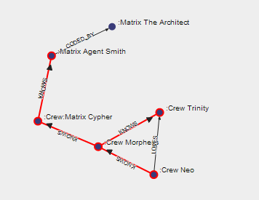

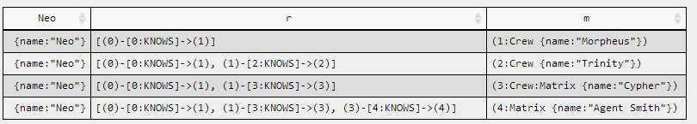
Cypher

Slide 24
SQL Server for graphs

Slide 25
Build the model
Node table➔One for each entity
Edge Table➔Many opportunities
One for each relation
One for each “kind of” relation (hierarchies)
One for each type of relation
One for all “relations” (untyped)

Slide 26
Node Table
CREATE TABLE Components
(
ComponentID INT IDENTITY PRIMARY KEY,
ComponentName NVARCHAR(100) NOT NULL,
ComponentDescription NVARCHAR(100) NOT NULL
) AS NODE;

Slide 27
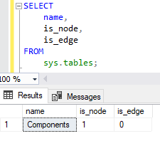
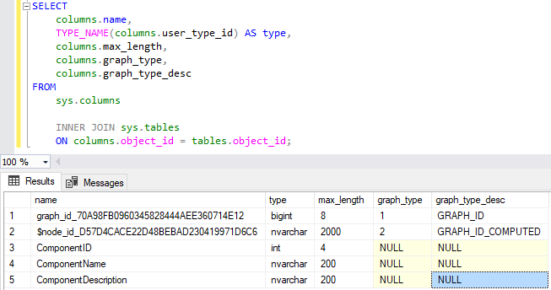
Node Table
sys.tables and sys.columns updated
$node_id column: node unique in the db
$node_id values automatically generated (object_id + a bigint)

Slide 28

Node Table
$node_id is showed as json value
https://docs.microsoft.com/en-us/sql/relational-databases/graphs/sql-graph-architecture?view=sql-server-2017

Slide 29
Edge Table
CREATE TABLE Write AS EDGE;
CREATE TABLE Reference AS EDGE;
CREATE TABLE Likes
(
score int
)
AS EDGE;

Slide 30
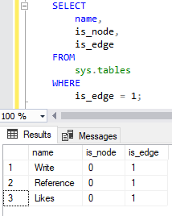
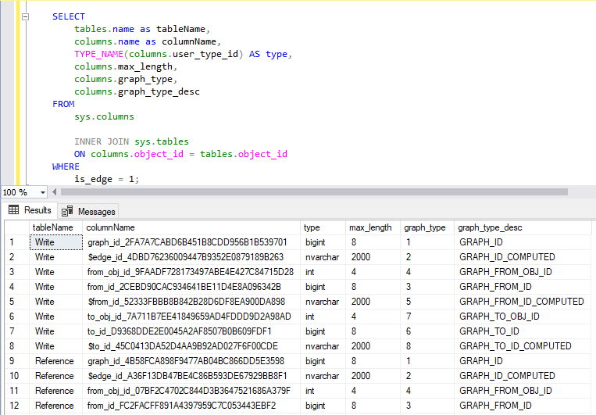
Edge Table
Changed sys.tables and sys. columns views $edge _id Column: Uniquely identifies an edge instance in the database The values in $edge _id are automatically generated (object_id + bigint value generated)

Slide 31
Edge Table
When the $edge _id column is selected, a computed value in the form of a JSON string is displayed. $from _id contains the source $node _id $to _id contains the target $node _id

Slide 32
Query graph db
SELECT
DevAdmins.Nickname,
Components.ComponentName,
Components.ComponentDescription
FROM
DevAdmins
INNER JOIN Likes
ON DevAdmins.$node_id = Likes.$from_id
INNER JOIN Components
ON Likes.$to_id = Components.$node_id;
Path is a set of inner joins

Slide 33
Query graph db – MATCH function
Has been specifically added to query graph tables It is only possible to use it in the WHERE of a SELECT that queries NODE and EDGE table You can combine it with other WHERE clauses, but only in and
or, and not are unavailable.

Slide 34
Query graph db – MATCH function
SELECT
DevAdmins.Nickname,
Components.ComponentName,
Components.ComponentDescription
FROM
DevAdmins
INNER JOIN Likes
ON DevAdmins.$node_id = Likes.$from_id
INNER JOIN Components
ON Likes.$to_id = Components.$node_id;
SELECT
DevAdmins.Nickname,
Components.ComponentName,
Components.ComponentDescription
FROM
DevAdmins, Likes, Components
WHERE
MATCH(DevAdmins-(Likes)->Components);

Slide 35
Query graph db – MATCH function
SELECT
DevAdmins.Nickname,
Articles.Title,
Components.ComponentDescription
FROM
DevAdmins, Write, Articles, Reference, Components
WHERE
MATCH(DevAdmins-(Write)->Articles-(Reference)->Components);

Slide 36
Query graph db – MATCH function
SELECT
DevAdmins.Nickname,
Articles.Title,
DevAdminsLike.Nickname
FROM
DevAdmins, Write, Articles, Likes, DevAdmins DevAdminsLike
WHERE
MATCH(DevAdmins-(Write)->Articles<-(Likes)-DevAdminsLike);

Slide 37
Other functions
Node table functions
OBJECT_ID_FROM_NODE_ID($node_id)
GRAPH_ID_FROM_NODE_ID($node_id)
NODE_ID_FROM_PARTS(object_id, graph_id)
Edge table functions
OBJECT_ID_FROM_EDGE_ID($edge_id)
GRAPH_ID_FROM_EDGE_ID($edge_id)
EDGE_ID_FROM_PARTS(object_id, graph_id)

Slide 38
Delete & Update
DELETE Likes
FROM
DevAdmins, Likes, Components
WHERE
MATCH(DevAdmins-(Likes)->Components)
AND ComponentID = 3;
DELETE Likes
WHERE
$edge_id = '{"type":"edge","schema":"dbo","table":"Likes","id":8}';

Slide 39
Best practice
SQL does not create unique indexes SQL does not create constraint We have to create unique indices in both nodes and edge tables to avoid duplicates There is no constraint on the edges that restrict the type of node tables source or destination

Slide 40
Hierarchies
Venues
House 01
Office 02
Basement
Floor 1
Floor 2
House 03
Bath
Bath
Bath
Bath
Office1
Office2
Basement
Floor 1
Temperature Sensor
Temperature Sensor

Slide 41
Hierarchies
CREATE TABLE Space
(
SpaceId INT IDENTITY PRIMARY KEY,
Name NVARCHAR(50) NOT NULL,
LastNTypeame NVARCHAR(50) NOT NULL
) AS NODE;
CREATE TABLE Contains AS EDGE;
CREATE TABLE Contained AS EDGE;
Space
Contained
Contains

Slide 42
Limitations
Not Available
Transitive Closure
Polymorphism
Functions such as Shortest Path or Page Rank Graphical View
Not Supported
Converting existing relational table to node or edge
memory-optimized, system-versioned, or temporary tables
updating node IDs in edge records
View Designer
Referential Integrity
Notes:
Limitations
This release of SQL graph is definitely not ready for production systems. It lacks a number of very important features. It should be considered a version 0.1.
I guess Microsoft have added it to show customers that they are serious about graph processing to encourage people who might be considering other vendors, such as Neo4j to hang on
Transitive Closure - How do I find a node connected to me, an arbitrary number of hops away, in my graph?
The ability to recurse through a combination of nodes and edges, an arbitrary number of times, is called transitive closure.
e.g. Find all the people connected to me through three levels of indirections or find the employee chain for a given employee in an organization.
Transitive closure is not supported in the first release. A recursive CTE or a T-SQL loop may be used to work around these types of queries.
Polymorphism - How do I find ANY Node connected to me in my graph?
The ability to find any type of node connected to a given node in a graph is called polymorphism.
SQL graph does not support polymorphism in the first release.
A possible workaround is to write queries with UNION clause over a known set of node and edge types. However, this workaround is good for a small set of node and edge types.
Functions - Are there special graph analytics functions introduced?
Some graph databases provide dedicated graph analytical functions like “shortest path” or “page rank.”
SQL Graph does not provide any such functions in this release. Again, T-SQL loops and temp tables may be used to write a workaround for these scenarios.
Not Supported
Is the new MATCH syntax supported on relational tables?
No. MATCH clause works only on graph node and edge tables.
Can I alter an existing table into a node or edge table?
No. In the first release, ALTER TABLE to convert an existing relational table into a node or edge table is not supported.
Users can create a node table and use INSERT INTO … SELECT FROM to populate data into the node table.
To populate an edge table from an existing table, proper $from_id and $to_id values must be obtained from the node tables.
What are some table operations that are not supported on node or edge tables?
In the first release, node or edge tables cannot be created as memory-optimized, system-versioned, or temporary tables.
Stretching or creating a node or edge table as external table (PolyBase) is also not supported in this release.
Can’t Update
Can’t currently update edge IDs in edge records so if any changes you need to make then you will have to delete the record and re create it.
Referential Integrity
You can delete records from nodes even if there are records I the related edge tables

Slide 43
Cosa manca
UNION
Polymorphism (recursive search on all nodes and arcs)
LOOP
Transitive closure (recursive search for specific nodes, arcs, and depths)
LOOP & Temp Table
Shortest path
LOOP & TempTable
Page rank

Slide 44
Demo

Slide 45
Cosmos DB for graphs
Notes:
Cosmos DB is Azure’s NoSQL Database-as-a-Service, born in cloud, globally distributed, highly scalable & highly available.
The first & only globally distributed, multi-model database system
2010 Project Florence
2014 DocumentDB
2017 Cosmos DB

Slide 46
CosmosDb
Attend Marco Minerva & Riccardo Cappello session!
Global Distribution
Single Digit Latency
Collection-based/RU-based
Multi-master
Tweakable consistency
Multi-Model

Slide 47
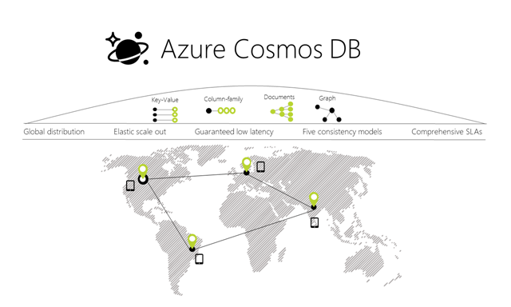
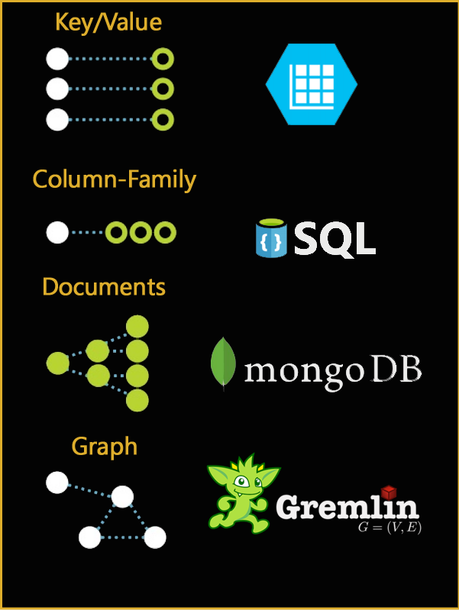
Multimodel (and API)
Database engine operates on atom-record-sequence (ARS) based type system
https://azure.microsoft.com/it-it/blog/a-technical-overview-of-azure-cosmos-db/
All data models are efficiently translated to ARS
API and wire protocols are supported via extensible modules
Instance of a given data model can be materialized as trees
Graph, documents, key-value, column-family, … more to come (MongoDb, Cassandra, Table, Sql, Gremlin)

Slide 48
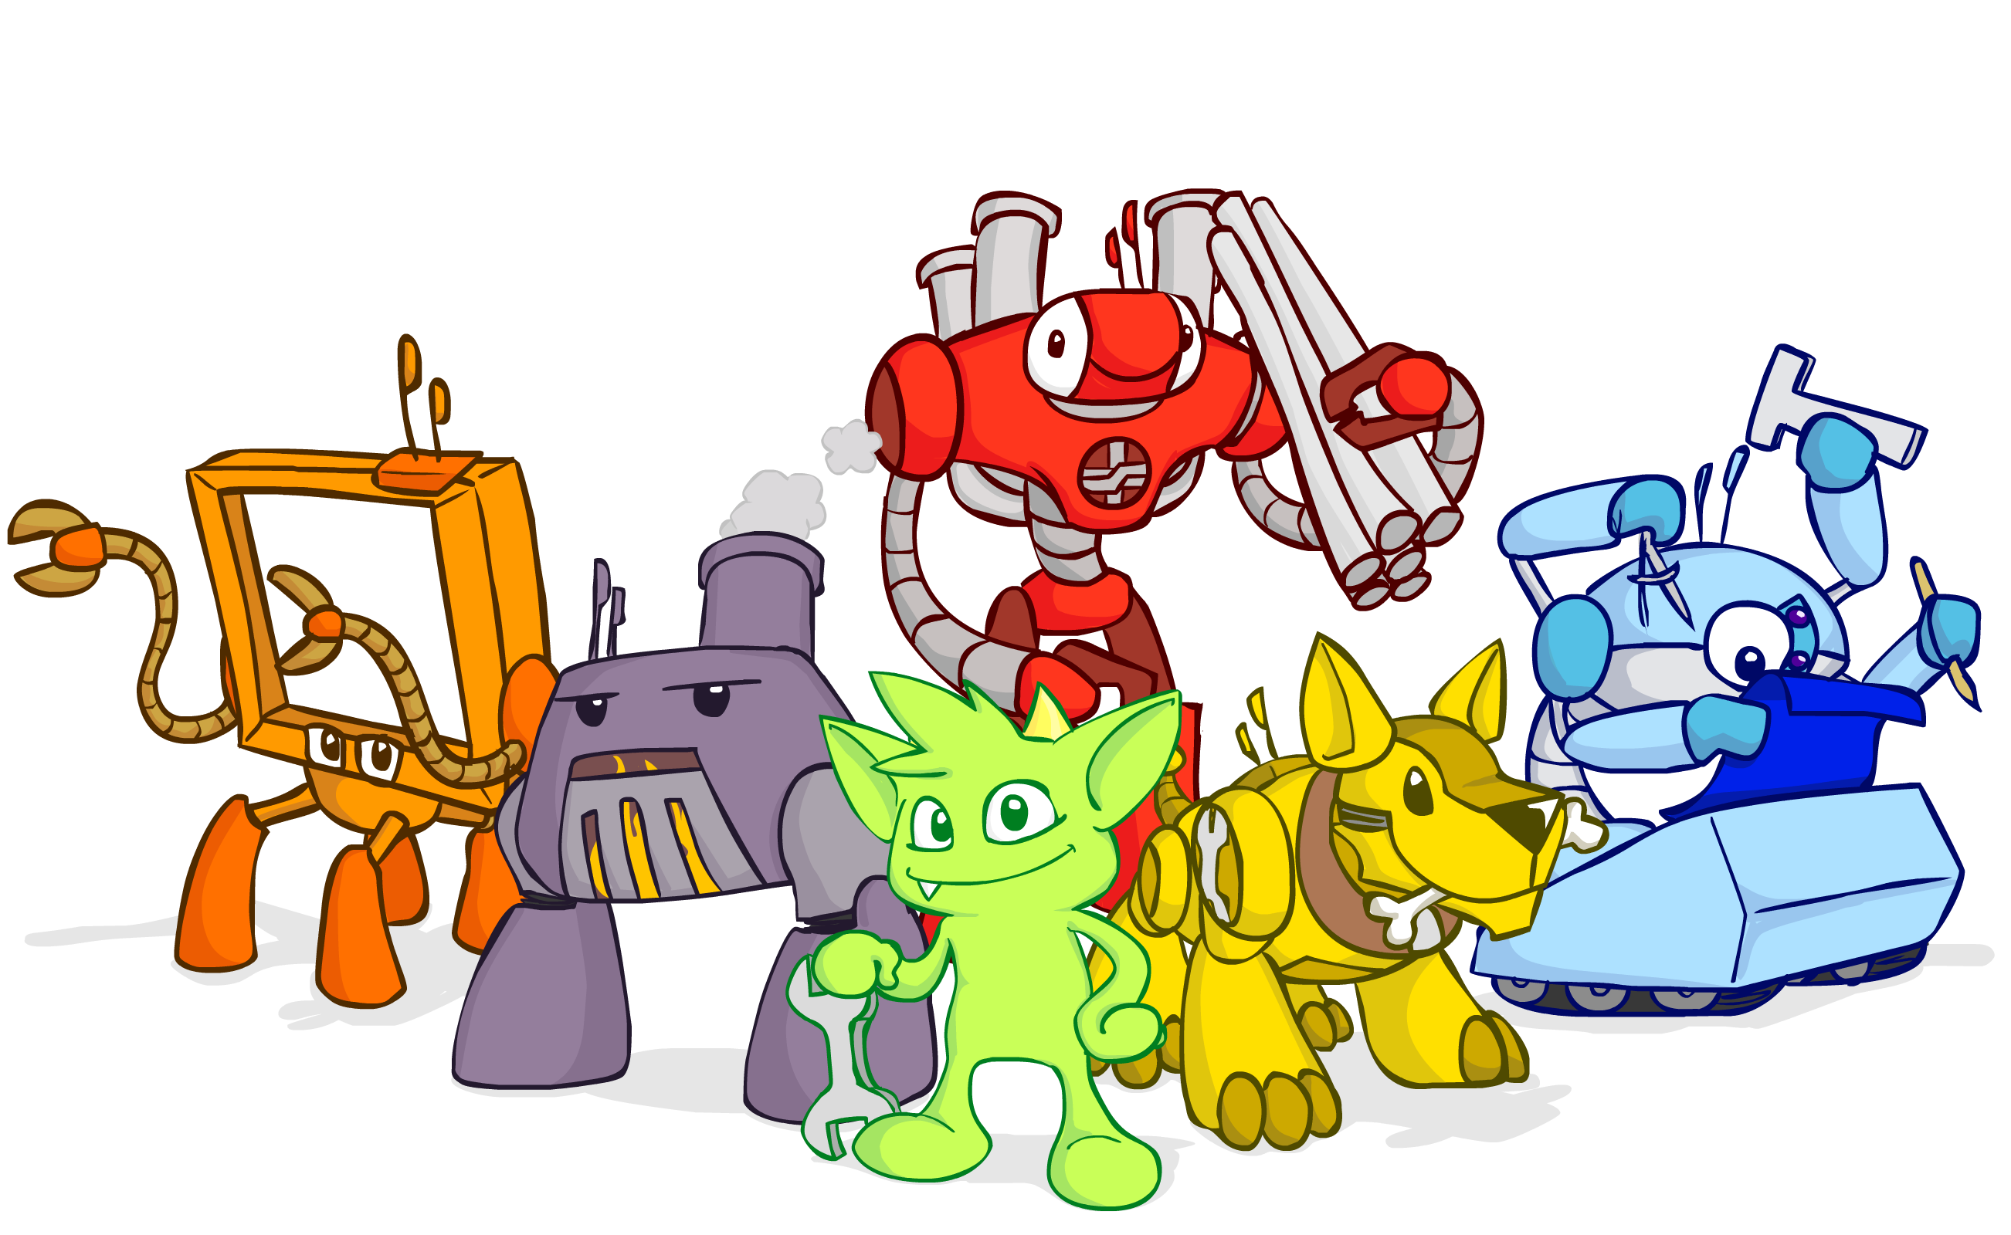
Gremlin - Apache TinkerPop
Apache TinkerPop™ is an open source, vendor-agnostic, graph computing framework distributed under the commercial friendly Apache2 license.
When a data system is TinkerPop-enabled, its users are able to model their domain as a graph and analyze that graph using the Gremlin graph traversal language.

Slide 49
Some commands
Insert Vertex | g.addV('employee').property('id', 'u001').property('firstName’, 'John').property('age', 44) No
Insert Edge | g.V('u002').addE('manager').to(g.V('u001’))
Update | g.V().hasLabel('employee').has('firstName','John').property('age', 45)
Delete vertex | g.V('u006').drop()
Delete edge | g.V('u006').outE('friend').drop

Slide 50
Some commands
Predicate filter | g.V().hasLabel('employee')
Projection | g.V().hasLabel('employee').values("firstName")
Operators | g.V().hasLabel('employee').has('age', gt(40))
Combining | g.V().hasLabel('employee').and(has('age', gt(35)), has('age', lt(40)))
Moving throug the edges | g.V('u002').outE('manager').inV().hasLabel('employee')
 | g.V('u002').out('manager').hasLabel('employee').in('manager').hasLabel('employee')
 | g.V('u006').both('friend').hasLabel('employee')
Order by | g.V('u006').both('friend').hasLabel('employee').order().by('firstName', decr).values("firstName")
Repeat until | g.V('u006').repeat(union(both('friend').simplePath(), out('manager').simplePath())).until(has('id', 'u001')).path()
aggregating | g.V('u006').repeat(union(both('friend').simplePath(), out('manager').simplePath())).until(has('id', 'u001')).path().count(local)

Slide 51
API for apps
Gremlin presents a server
Query expressed as Text
In C# created Gremlin.NET to create «expression»-like code
Azure Cosmos as a server text API

Slide 52
Demo

Slide 53
Conclusions
Notes:
Cosmos DB is Azure’s NoSQL Database-as-a-Service, born in cloud, globally distributed, highly scalable & highly available.
The first & only globally distributed, multi-model database system
2010 Project Florence
2014 DocumentDB
2017 Cosmos DB

Slide 54
ThinkerPop in a Container
docker pull tinkerpop/gremlin-server on premise or AKS or Container Instance (so no CosmosDb)
But I had no time to test Gremlin.Net without CosmosDb

Slide 55
Conclusions
Graphs are not new
Graphs have matured
Give them a try
THANKS! @marco_parenzan

